Slide 1
Decrease and Conquer II

Slide 2
Decrease and Conquer
“Decrease and Conquer is based on exploiting the relationship between a solution to a given problem instance of a problem and a solution to a smaller instance.”
Decrease by a Constant
Decrease by a Constant Factor
Variable Size Decrease

Slide 3
Recap: Decrease and Conquer for Combinatorial Objects
Decrease by One: build objects of size n from objects of size n-1.
n | Subsets
0 | {}
1 | {} {1}
2 | {} {2} {1} {1 2}
3 | {} {3} {2} {2 3} {1} {1 3} {1 2} {1 2 3}

Slide 4
Decrease by One: Subsets
ALG GenSubsets (n)
subsets = {}
if n = 0
subsets.append({})
else
smaller ← GenSubsets(n-1)
for s in smaller
subsets.append(s)
subsets.append(s U n)
return subsets

Slide 5
Recap: Decrease and Conquer for Combinatorial Objects
Decrease by One: build objects of size n from objects of size n-1.
n | Permutations
0 | []
1 | [1]
2 | [2 1] [1 2]
3 | [3 2 1] [2 3 1] [2 1 3] [3 1 2] [1 3 2] [1 2 3]

Slide 6
Decrease by One: Permutations
ALG GenPerms (n)
perms = {}
if n = 0
perms.append([])
else
smaller ← GenPerms(n-1)
for s[0…j-1] in smaller
for i ← 0 to j
perms.append(s[0:i] + n + s[i:])
return perms

Slide 7
Decrease By Half
Constant Factor

Slide 8

Binary Search
BinarySearch(A[0…n-1], K)
l ← 0
r ← n-1
while l ≤ r do
m ← $\left\lfloor \left(\text{l}\text{+}\text{r}\right) \text{/2}\right\rfloor$
if K = A[m]
return m
else if K < A[m]
r ← m – 1
else
l ← m + 1
return -1

Slide 9

Binary Search
$C_{worst}\left(n\right)=C_{worst}\left(\left\lfloor \frac{n}{2}\right\rfloor \right)+1,$ for n > 1, $C_{worst}\left(1\right)=1$

Slide 10
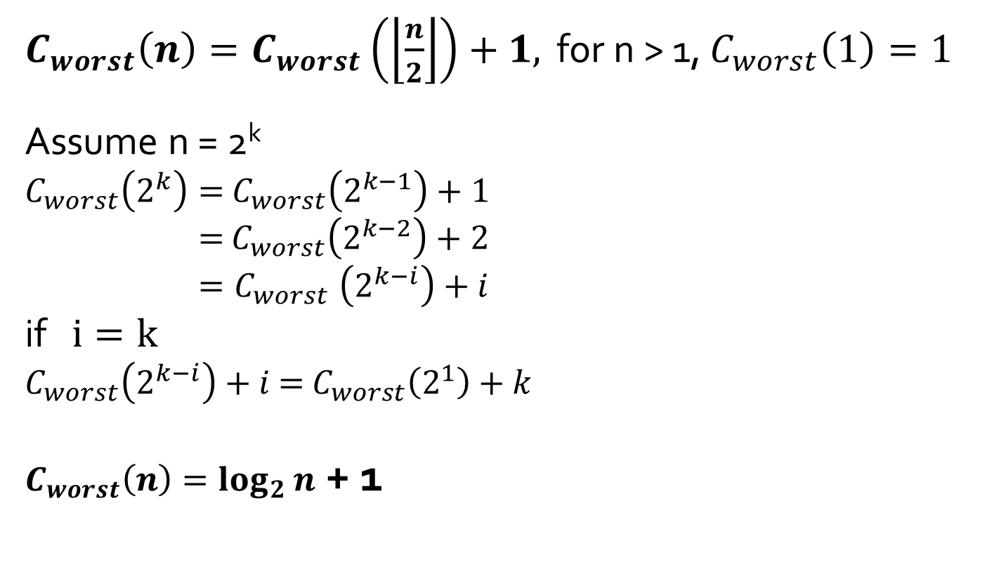
Binary Search
$C_{worst}\left(n\right)=C_{worst}\left(\left\lfloor \frac{n}{2}\right\rfloor \right)+1,$ for n > 1, $C_{worst}\left(1\right)=1$
Assume n = 2^{k}
$C_{worst}\left(2^{k}\right)=$ $C_{worst}\left(2^{k−1}\right)+1$
$=$ $C_{worst}\left(2^{k−2}\right)+2$
${=C}_{worst}\left(2^{k−i}\right)+i$ if $i=k$
$C_{worst}\left(2^{k−i}\right)+i$ = $C_{worst}\left(2^{1}\right)+k$
$C_{worst}\left(n\right)=\log_{2}{n}$ + 1

Slide 11
Fake-Coin Problem
Among n identical-looking coins, one is fake (lighter). With a balance scale, you can compare any two sets of coins. Find the fake with as few comparisons as possible.
Ideas?

Slide 12
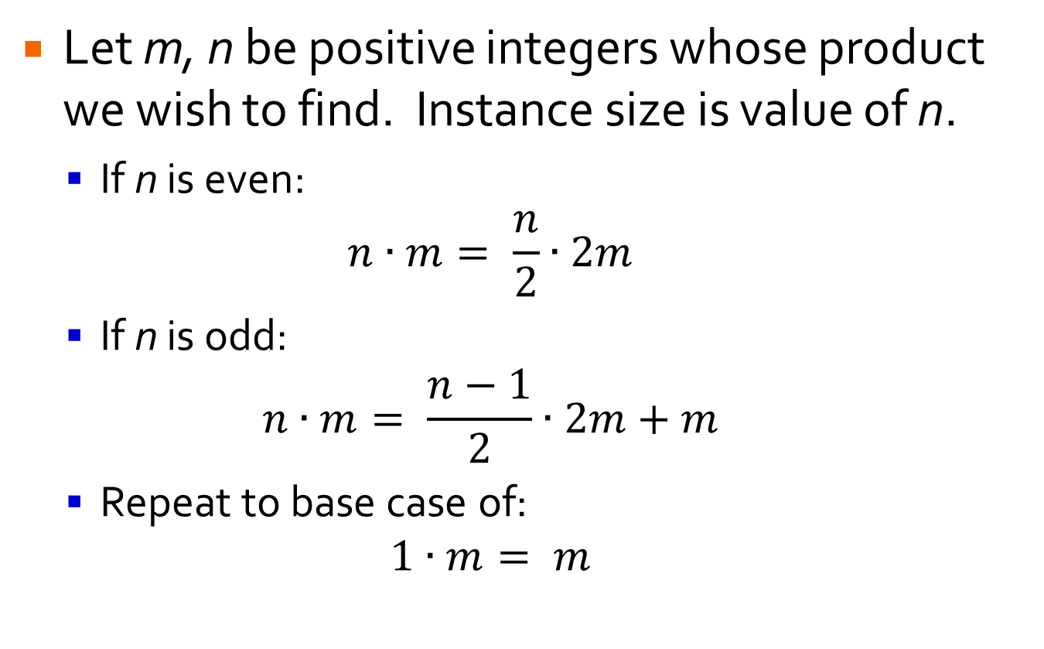
Russian Peasant Multiplication
Let m, n be positive integers whose product we wish to find. Instance size is value of n.
If n is even: $n∙m= \frac{n}{2}∙2m$
If n is odd:
$$n∙m= \frac{n−1}{2}∙2m+m$$
Repeat to base case of: $1∙m= m$
Try 50 * 65

Slide 13
Russian Peasant Multiplication
Let m, n be positive integers whose product we wish to find. Instance size is value of n.
If n is even: $n∙m= \frac{n}{2}∙2m$
If n is odd:
$$n∙m= \frac{n−1}{2}∙2m+m$$
Repeat to base case of: $1∙m= m$
Can be implemented efficiently in hardware since doubling / halving binary numbers involves shifts.

Slide 14
Variable Size Decrease Algorithms

Slide 15
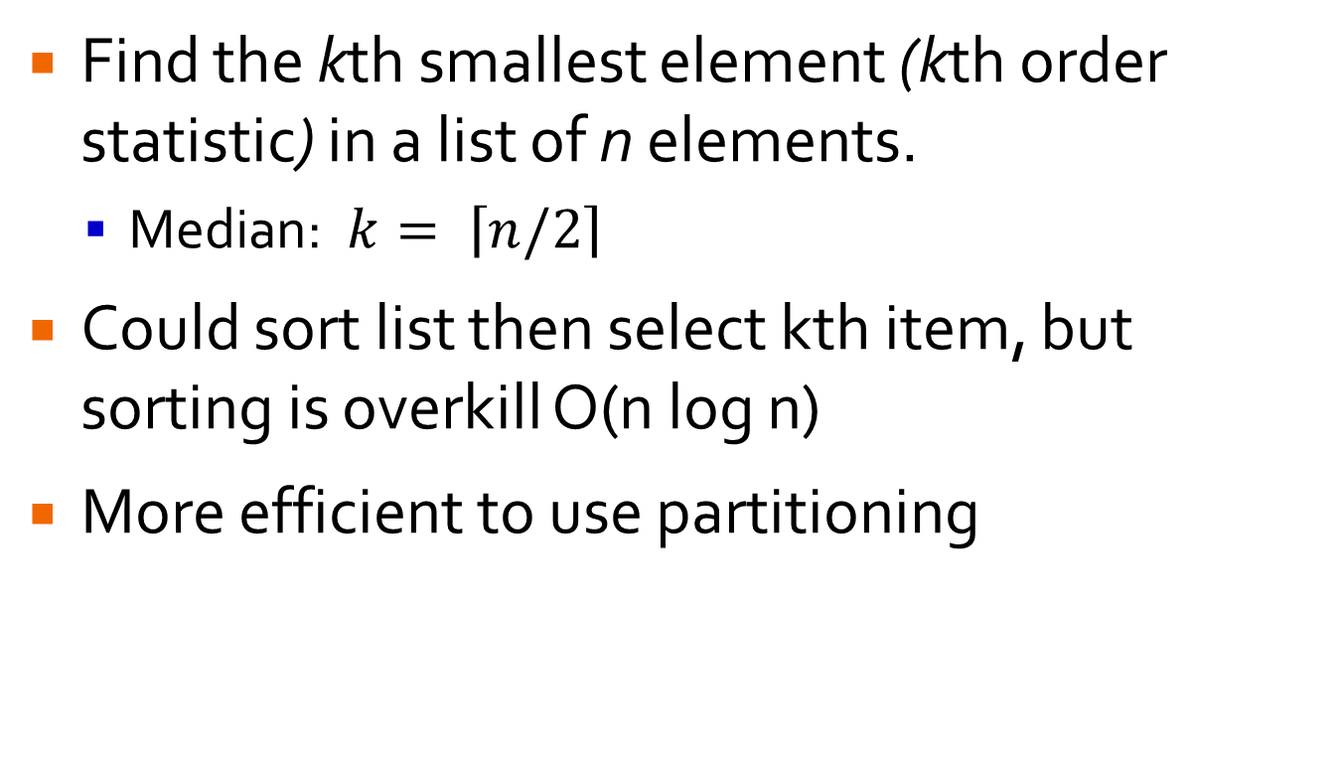
Selection Problem
Find the kth smallest element (kth order statistic) in a list of n elements.
Median: $k= \left\lceil n/2\right\rceil$
Could sort list then select kth item, but sorting is overkill O(n log n)
More efficient to use partitioning

Slide 16
Selection Problem
Partitioning: rearrange a given list around pivot, p, such that left contains all elems < p, then p, then all elems ≥ p.
Use Lomuto partitioning
p | < p | ≥ p | ?
Notes:
Hoare’s partitioning more efficient – topic of divide and conquer chapter

Slide 17
Lomuto Partitioning
Consider subarray: A[l…r], 0 ≤ l ≤ r ≤ n-1
Scan unknown section of array (orig i = l + 1):
If A[i] ≥ p, consider it part of third section, increment i.
Else, swap first item from third section with item i.
p | < p |  |  | ≥ p |  |  |  | ?
l |  |  | s |  |  |  |  | i |  |  |  | r
Notes:
Hoare’s partitioning more efficient – topic of divide and conquer chapter

Slide 18
Lomuto Partitioning
LomutoPartition(A[l…r])
p ← A[l]
s ← l
for i ← l + 1 to r do
if A[i] < p
s ← s + 1
swap(A[s], A[i])
swap(A[l], A[s])
return s
p | < p |  |  | ≥ p |  |  |  | ?
l |  |  | s |  |  |  |  | i |  |  |  | r
Notes:
Hoare’s partitioning more efficient – topic of divide and conquer chapter

Slide 19
Lomuto Partitioning
Partition the following array:
8 | 1 | 10 | 16 | 7 | 12 | 9 | 2 | 15
l | i,s |  |  |  |  |  |  | r

Slide 20
Selection Problem
QuickSelect(A[l…r],k)
s ← LomutoPartition(A[l…r])
if s = k – 1
return A[s]
else if s > k – 1
return QuickSelect(A[l…s-1],k)
else
return QuickSelect(A[s+1…r],k-1-s)
Use QuickSelect to find 5th element of following
4 | 1 | 10 | 8 | 7 | 12 | 9 | 2 | 15

Slide 21
QuickSelect
Best Case: Θ(n)
Worst Case: Θ(n²)
Average Case: Θ(n)

Slide 22
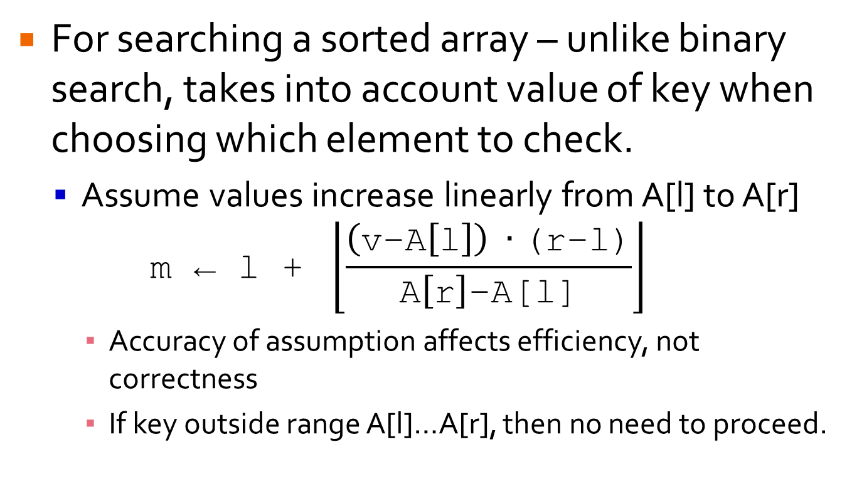
Interpolation Search
For searching a sorted array – unlike binary search, takes into account value of key when choosing which element to check.
Assume values increase linearly from A[l] to A[r] $\text{m}\text{ ← }\text{l}\text{ + }\left\lfloor \frac{\left(\text{v}\text{−}\text{A}\left[\text{l}\right]\right) ∙\text{(}\text{r}\text{−}\text{l}\text{)}}{\text{A}\left[\text{r}\right]\text{−}\text{A}\text{[}\text{l}\text{]}}\right\rfloor$
Accuracy of assumption affects efficiency, not correctness
If key outside range A[l]…A[r], then no need to proceed.

Slide 23
Interpolation Search
Best Case: Θ(1)
Worst Case: Θ(n)
Average Case: log₂(log₂n) + 1

Slide 24
Search/Insert into BST
Best Case: Θ(log₂n)
Worst Case: Θ(n)
Average Case: 1.39 * log₂n
34
50
19
1
21
46
87

